Slide 1
A modified RRT algorithm for quad-rotor motion planning
Group 6
Andrei-Carlo Papuc - 4772385
Benjamin Bogenberger - 5845033
Crina Mihalache - 4827333
Simon Gebraad - 4840232

Slide 2
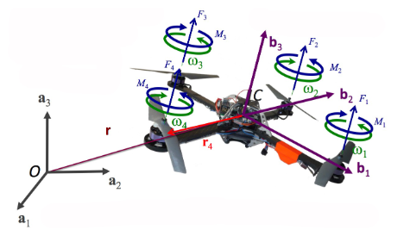

Model and Planning

Slide 3
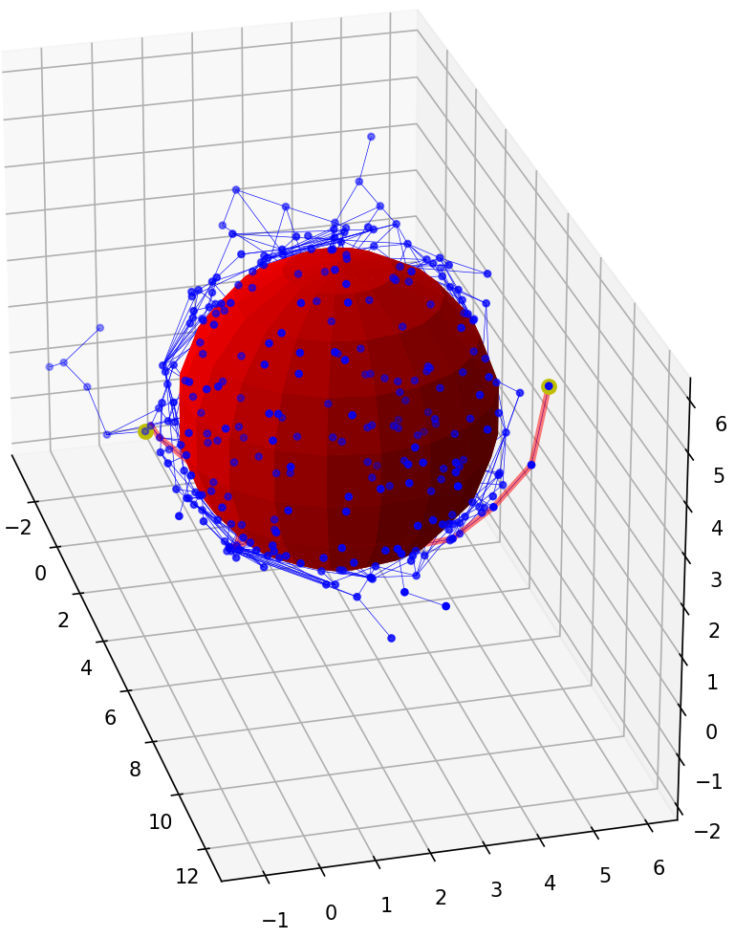
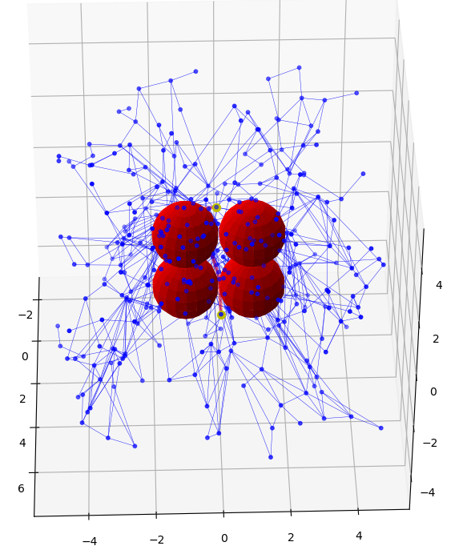
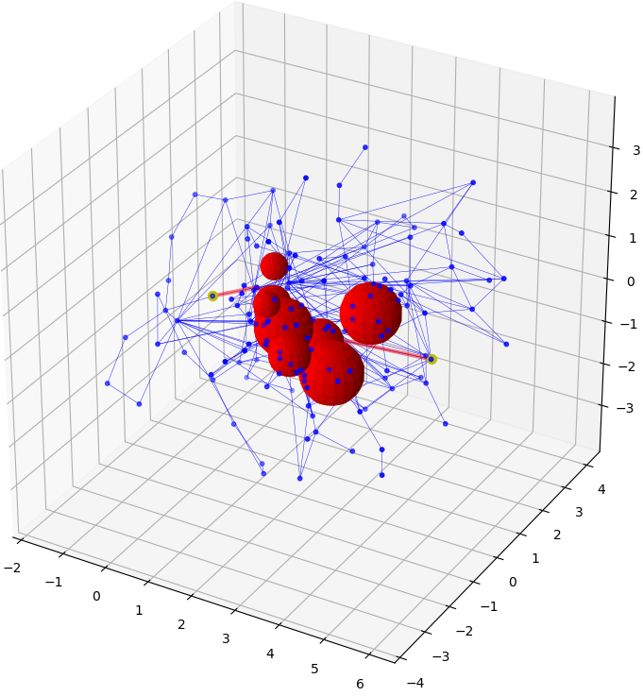
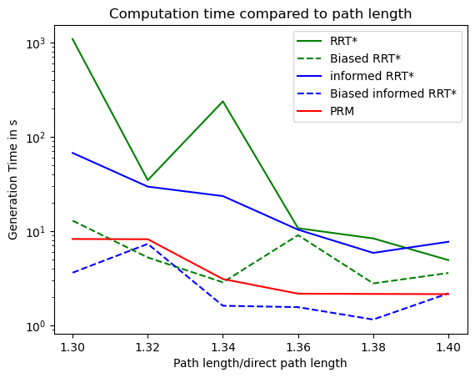
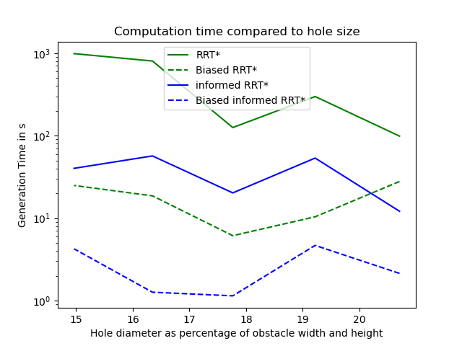
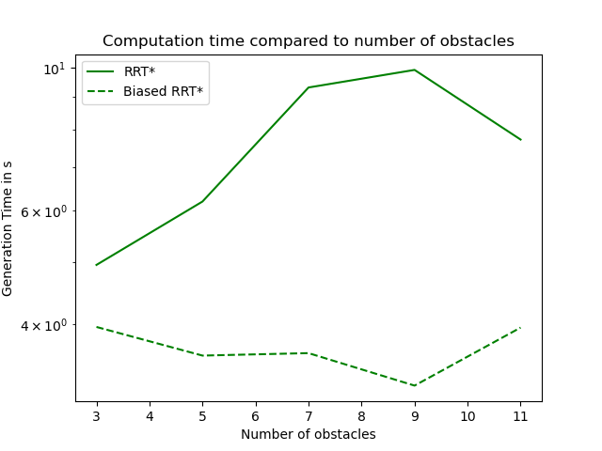
Results
Setup
Graph/plot/table

Slide 4
Results
Video

Slide 5
Discussion
Promising benefits
Especially for larger number of obstacles or small holes
Useful for crowded (indoor) environments
Future research
More trials for statistical significance
Expand to non-spherical objects and higher configuration space
Optimize code
Dynamic recomputation of path
Practical implementation and testing

